Slide 1
AlexNet---- CNN

Slide 2
What is ImageNet?
ImageNet is formally a project aimed at (manually) labeling and categorizing images into almost 22,000 separate object categories for the purpose of computer vision research.
The goal of this image classification challenge is to train a model that can correctly classify an input image into 1,000 separate object categories.
Models are trained on ~1.2 million training images with another 50,000 images for validation and 100,000 images for testing.
These 1,000 image categories represent object classes that we encounter in our day-to-day lives, such as species of dogs, cats, various household objects, vehicle types, and much more.

Slide 3
ImageNet dataset
When it comes to image classification, the ImageNet challenge is the de facto benchmark for computer vision classification algorithms — and the leaderboard for this challenge has been dominated by Convolutional Neural Networks and deep learning techniques since 2012.
The state-of-the-art pre-trained networks included in the Keras core library represent some of the highest performing Convolutional Neural Networks on the ImageNet challenge over the past few years.
These networks also demonstrate a strong ability to generalize to images outside the ImageNet dataset via transfer learning, such as feature extraction and fine-tuning.

Slide 4
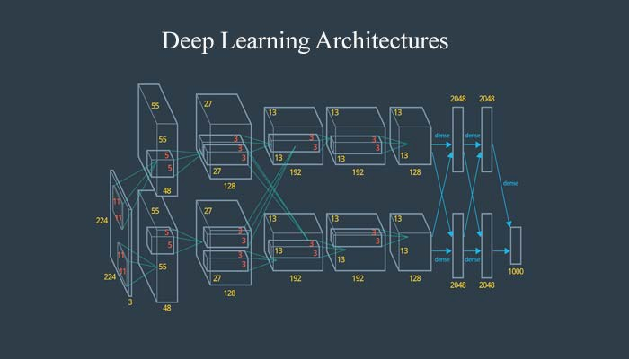
The AlexNet contains 8 layers with weights;
5 convolutional layers
3 fully connected layers.

Slide 5
AlexNet
Named after the First Authors name: ‘Alex’
Alex Krizhevsky, Ilya Sutskever, Geoffrey E. Hinton, ImageNet Classification with Deep Convolutional Neural Networks, Published as a conference paper at NIPS, Sept 2012
All from University of Toronto
ILSVRC-2012 competition, Won Prize. Achieved a winning top-5 test error rate of 15.3%, compared to 26.2% achieved by the second-best entry.

Slide 6
ImageNet Classification with Deep ConvolutionalNeural Networks (Alex Krizhevsky ,Ilya Sutskever ,Geoffrey E. Hinton)
Trained a large, deep convolutional neural network to classify the 1.2 million high-resolution images in the ImageNet LSVRC-2010 contest into the 1000 different classes.
On the test data, achieved top-1 and top-5 error rates of 37.5% and 17.0% which is considerably better than the previous state-of-the-art.
The neural network, which has 60 million parameters and 650,000 neurons, consists of five convolutional layers, some of which are followed by max-pooling layers, and three fully-connected layers with a final 1000-way softmax.
To make training faster, used non-saturating neurons and a very efficient GPU implementation of the convolution operation.
To reduce overfitting in the fully-connected layers employed a recently-developed regularization method called “dropout” that proved to be very effective.

Slide 7
The specific contributions of this paper are as follows
Trained one of the largest convolutional neural networks to date on the subsets of ImageNet used in the ILSVRC-2010 and ILSVRC-2012
competitions and achieved by far the best results ever reported on these datasets.
Use highly-optimized GPU implementation of 2D convolution and all the other operations inherent in training convolutional neural networks, which we make available publicly1.
Network contains a number of new and unusual features which improve its performance and reduce its training time,
The size of our network made overfitting a significant problem, even with 1.2 million labeled training examples, so used several effective techniques for preventing overfitting.
Final network contains five convolutional and three fully-connected layers, and this depth seems to be important: found that removing any convolutional layer (each of which contains no more than 1% of the model’s parameters) resulted in inferior performance.
In the end, the network’s size is limited mainly by the amount of memory available on current GPUs and by the amount of training time that are willing to tolerate.
Network takes between five and six days to train on two GTX 580 3GB GPUs. All of our experiments suggest that results be improved simply by waiting for faster GPUs and bigger datasets to become available.

Slide 8
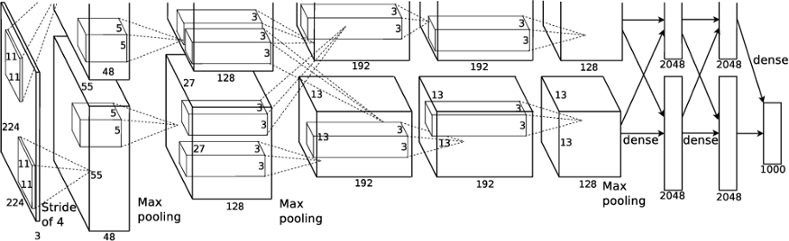
AlexNet

Slide 9
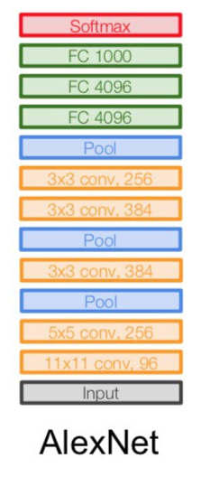
AlexNet Layers Details [2]
At the end of each layer, ReLu activation is performed except for the last one, which outputs with a softmax with a distribution over the 1000 class labels.
Dropout is applied in the first two fully connected layers.
As the figure above shows also applies Max-pooling after the first, second, and fifth convolutional layers.
The kernels of the second, fourth, and fifth convolutional layers are connected only to those kernel maps in the previous layer, which reside on the same GPU.
The kernels of the third convolutional layer are connected to all kernel maps in the second layer.
The neurons in the fully connected layers are connected to all neurons in the previous layer.

Slide 10
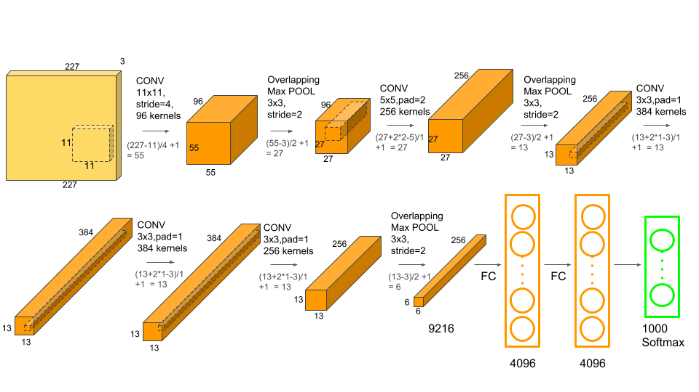

Slide 11
AlexNet
AlexNet is the first large scale convolutional neural network architecture that does well on ImageNet classification.
AlexNet was entered into the competition and was able to outperform all previous non-deep learning-based models by a significant margin.
AlexNet architecture is a conv layer followed by pooling layer, normalization, conv-pool-norm, and then a few more conv layers, a pooling layer, and then several fully connected layers afterwards.
Actually looks very similar to the LeNet network. There are just more layers in total. There are five of these conv layers, and two fully connected layers before the final fully connected layer going to the output classes.

Slide 12
AlexNet Achitecture
AlexNet was trained on ImageNet, with inputs at a size 227 x 227 x 3 images. If we look at this first layer which is a conv layer for the AlexNet, it’s 11 x 11 filters, 96 of these applied at stride 4.
AIexNet had 55 x 55 x 96 in the output and 35K parameters in this first layer. The second layer is a pooling layer and in this case, we have 3 filters of 3 x 3 applied at stride 2. The output volume of the pooling layer is 27 x 27 x 96 with and 0 parameter to learn.
The pooling layer does not learn anything because the parameters are the weights which trying to learn. Convolutional layers have weights that we learn but pooling all we do is have a rule, we look at the pooling region, and we take the max. So there are no parameters that are learned.
There are 11 x 11 filters at the beginning, then five by five and some three by three filters. In the end, we have a couple of fully connected layers of size 4096 and finally, the last layer, is FC8 going to the softmax, which is going to the 1000 ImageNet classes. This architecture is the first use of the ReLu non-linearity.

Slide 13
AlexNet Architecture
It contains 5 convolutional layers and 3 fully connected layers.
AlexNet, which employed an 8-layer convolutional neural network
Relu is applied after very convolutional and fully connected layer.
Dropout is applied before the first and the second fully connected year

Slide 14
ReLU Nonlinearity
A four-layer convolutional neural network with ReLUs (solid line) reaches a 25% training error rate on CIFAR-10 six times faster than an equivalent network with tanh neurons (dashed line).
The learning rates for each network were chosen independently to make training as fast as possible.
No regularization of any kind was employed.
The magnitude of the effect demonstrated here varies with network architecture, but networks with ReLUs consistently learn several times faster than equivalents with saturating neurons.

Slide 15
Local Response Normalization

Slide 16
Overlapping Pooling
Pooling layers in CNNs summarize the outputs of neighboring groups of neurons in the same kernel map.
Traditionally, the neighborhoods summarized by adjacent pooling units do not overlap
To be more precise, a pooling layer can be thought of as consisting of a grid of pooling units spaced s pixels apart, each summarizing a neighborhood of size z* z centered at the location of the pooling unit.
If set s = z, we obtain traditional local pooling as commonly employed in CNNs. If set s < z, obtain overlapping pooling.
This is use throughout network, with s = 2 and z = 3. This scheme reduces the top-1 and top-5 error rates by 0.4% and 0.3%, respectively, as compared with the non-overlapping scheme s = 2; z = 2, which produces output of equivalent dimensions.
It is generally observe during training that models with overlapping pooling find it slightly more difficult to overfit.

Slide 17
Hyperparameter :
This architecture is the first use of the ReLU non-linearity. AlexNet uses a layer of normalization also.
In data augmentation, ALexNet used flipping, jittering, cropping, colour normalization and these things.
Other parameters are Dropout with 0.5, SGD + Momentum with 0.9, initial learning rate 1e-2 and again reduced by 10 when validation accuracy become flat.
The regularization used in this network is L2 with a weight decay of 5e-4. It was trained on GTX580 GPU which contains 3GB of memory.
It has an error rate of 16.4 in the ImageNet Large Scale Visual Recognition Challenge(ILSVRC).

Slide 18
Reducing Overfitting
Neural network architecture has 60 million parameters.
Although the 1000 classes of ILSVRC make each training example impose 10 bits of constraint on the mapping from image to label, this turns out to be insufficient to learn so many parameters without considerable overfitting.
Data Augmentation
The first form of data augmentation consists of generating image translations and horizontal reflections., do this by extracting random 224224 patches (and their horizontal reflections) from the 256256 images and training our network on these extracted patches4. This increases the size of our training set by a factor of 2048, though the resulting training examples are, of course, highly interdependent. Without this scheme, network suffers from substantial overfitting, which would have forced us to use much smaller networks. At test time, the network makes a prediction by extracting five 224 224 patches (the four corner patches and the center patch) as well as their horizontal reflections (hence ten patches in all), and averaging the predictions made by the network’s softmax layer on the ten patches.
The second form of data augmentation consists of altering the intensities of the RGB channels in training images. Specifically, perform PCA on the set of RGB pixel values throughout the ImageNet training set. To each training image, add multiples of the found principal components, with magnitudes proportional to the corresponding eigenvalues times a random variable drawn

Slide 19
Dropout
The recently-introduced technique, called “dropout” , consists of setting to zero the output of each hidden neuron with probability 0.5.
The neurons which are “dropped out” in this way do not contribute to the forward pass and do not participate in backpropagation. So every time an input is presented, the neural network samples a different architecture, but all these architectures share weights.
This technique reduces complex co-adaptations of neurons, since a neuron cannot rely on the presence of particular other neurons. It is, therefore, forced to learn more robust features that are useful in conjunction with many different random subsets of the other neurons.
At test time, use all the neurons but multiply their outputs by 0.5, which is a reasonable approximation to taking the geometric mean of the predictive distributions produced by the exponentially-many dropout networks.

Slide 20
Pros of AlexNet
AlexNet is considered as the milestone of CNN for image classification.
Many methods, such as the conv+pooling design, dropout, GPU, parallel computing, ReLU, are still the industrial standard for computer vision.
The unique advantage of AlexNet is the direct image input to the classification model.
The convolution layers can automatically extract the edges of the images and fully connected layers learning these features
Theoretically the complexity of visual patterns can be effective extracted by adding more conv layer

Slide 21
Cons of AlexNet
AlexNet is NOT deep enough compared to the later model, such as VGGNet, GoogLENet, and ResNet.
The use of large convolution filters (5*5) is not encouraged shortly after that.
Use normal distribution to initiate the weights in the neural networks, can not effectively solve the problem of gradient vanishing, replaced by the Xavier method later.
The performance is surpassed by more complex models such as GoogLENet (6.7%), and ResNet (3.6%)

Slide 22
Conclusion
AlexNet is a work of supervised learning and got excellent results.
It was also important for selecting methods like dropout and data augmentation that helped the network's performance.
The AlexNet made revolutionary implementation on ConvNets that continues nowadays, such as ReLU and dropout.
It is not easy to have low classification errors without having overfitting.

